Slide 1
To test whole slide is visible

Slide 3

THE AGE OF THE EARTH
Does it matter to our faith?
Notes:
ONCE UPON A TIME
Understanding the mythology behind radioactive dating
The Age of the Earth DVD, Thousands Not Billions DVD, Thousands Not Billions, The Young Earth, The Great Turning Point.

Slide 4
Time:
It’s the crux of the worldview issue

Slide 5
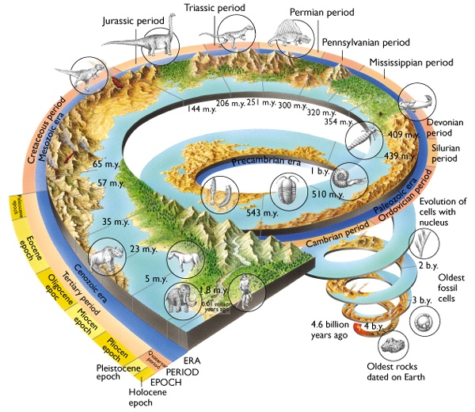
4.6 billion years

Slide 6


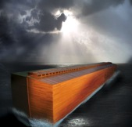





Biblical Worldview
Fall and Curse
Tower of Babel
Noah’s Flood
Jesus Christ
Restoration
Creation
Israel
6,000 years

Slide 7
Time:
A young earth kills naturalism

Slide 8
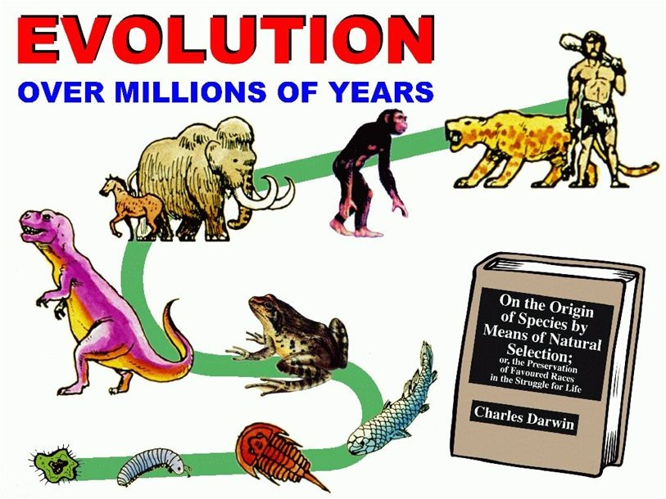
Is evolution true or false?

Slide 9
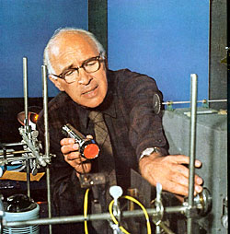
Time the Miracle Worker
“Time is in fact the hero of the plot … given so much time the ‘impossible’ becomes possible, the possible probable and the probable virtually certain. One has only to wait: time itself performs miracles.”
Wald, G., The Origin of Life, Physics and Chemistry of Life, p. 12, 1955
Notes:
Wald, G., The Origin of Life, Physics and Chemistry of Life, p. 12, 1955

Slide 10
Time:
An old earth destroys biblical Christianity

Slide 11
An old earth:
Destroys the credibility of the Bible

Slide 12
Exodus 20:11
For in six days the LORD made the heavens and the earth, the sea, and all that is in them, but he rested on the seventh day.

Slide 13
Genesis 1:31
God saw all that he had made, and it was very good. And there was evening, and there was morning—the sixth day.

Slide 14
Biblical literalism
“My primary aim is to demonstrate the age of the earth … for the simple reason that if the earth is more than 50,000 years old Biblical literalism is a dead duck. …
If I can persuade someone that the earth is at least a million years old I consider the war to be won.”
Michael Roberts, Cockerham, UK
Creationism on the Rocks, March 2003.
www.blackburn.anglican.org/science/geology.pdf

Slide 15
Number one sticking point
“I was raised in the church until my teens, before rejecting it and declaring myself an atheist/agnostic … the creation/evolution issue was the number one sticking point for me—how could I possibly believe the Bible if it was wrong from the very start …”
Kenneth M

Slide 16
An old earth:
Destroys the credibility of the Bible
Destroys the goodness of God

Slide 17
Genesis 1:31
God saw all that he had made, and it was very good …

Slide 18
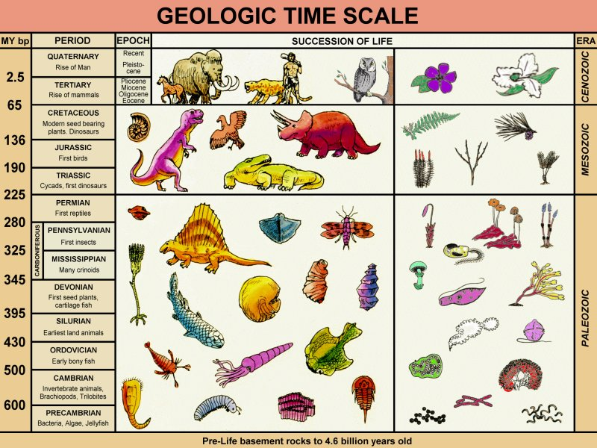
DEATH
SUFFERING
DISEASE

Slide 19

Do You Believe in a Higher Power?
"Every account of a higher power that I've seen described, of all religions that I've seen, include many statements with regard to the benevolence of that power. When I look at the universe and all the ways the universe wants to kill us, I find it hard to reconcile that with statements of beneficence."
Neil deGrasse Tyson
Notes:
https://en.wikipedia.org/wiki/Neil_deGrasse_Tyson
"Neil deGrasse Tyson at UB: God and Science". https://www.youtube.com/watch?v=wZhOm6N4-I0&feature=channel University at Buffalo YouTube channel. April 9, 2010. Quote starts at ~55 seconds. Retrieved September 19, 2016.

Slide 20
An old earth:
Destroys the credibility of the Bible
Destroys the goodness of God
Destroys the uniqueness of man

Slide 21
Genesis 1:26
Then God said, "Let us make man in our image, in our likeness, and let them rule over the fish of the sea and the birds of the air, over the livestock, over all the earth, and over all the creatures that move along the ground.”

Slide 22
Biblical Worldview
Fall and Curse
Tower of Babel
Noah’s Flood
Jesus Christ
Restoration
Creation
Israel
MAN

Slide 23
MAN

Slide 24
An old earth:
Destroys the credibility of the Bible
Destroys the goodness of God
Destroys the uniqueness of man
Destroys the basis of the gospel

Slide 25

Young Earth

Slide 26

Old Earth

Slide 27
An old earth:
Destroys the credibility of the Bible
Destroys the goodness of God
Destroys the uniqueness of man
Destroys the basis of the gospel
Destroys the credibility of Christ

Slide 28
Mark 10:6–8
“But at the beginning of creation God ‘made them male and female.’ ‘For this reason a man will leave his father and mother and be united to his wife, and the two will become one flesh.’ So they are no longer two, but one.”

Slide 29
An old earth:
Destroys the credibility of the Bible
Destroys the goodness of God
Destroys the uniqueness of man
Destroys the basis of the gospel
Destroys the credibility of Christ
Etc

Slide 30
Time:
A young earth kills naturalism.
An old earth destroys biblical Christianity.

Slide 31
I would have loved to believe
I would have loved to believe in a six thousand year old earth as that seemed to be the plain reading of Scripture but couldn’t. All authority seemed to point conclusively to millions and billions of years… ”
Martyn M.

Slide 32

Singapore Evolution Garden

Slide 33

Singapore Evolution Garden

Slide 34
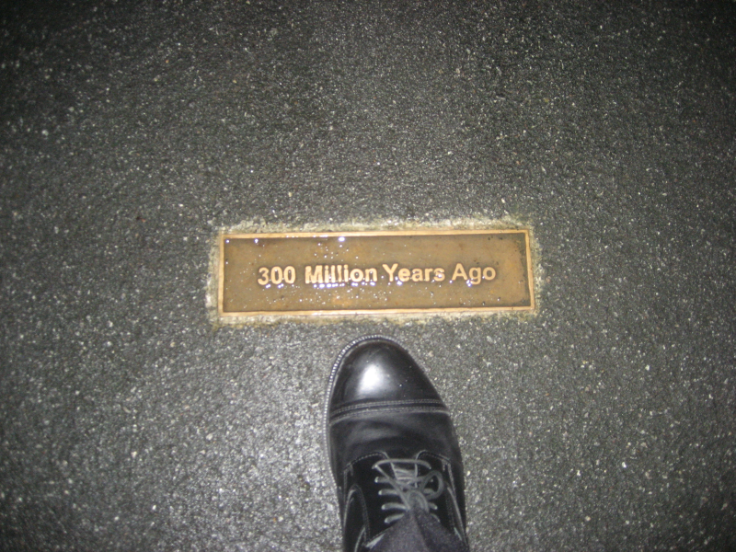
Singapore Evolution Garden

Slide 35
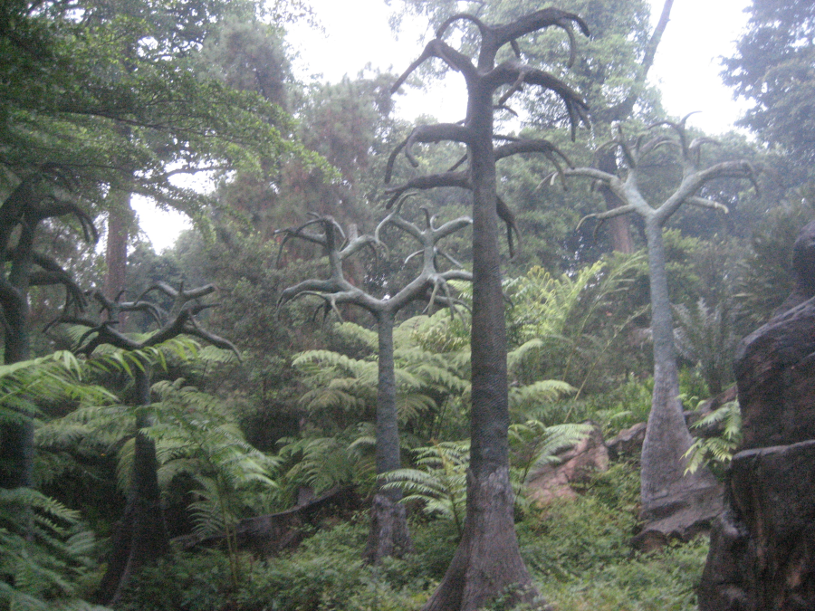
Singapore Evolution Garden
Notes:
Lepidodendron, an extinct genus of vascular, tree plants related to the clubmosses. The towering models of Lepidodendron with their scale-like trunks that you see here represent the Carboniferous era. (Evolution gardens brochure)

Slide 36
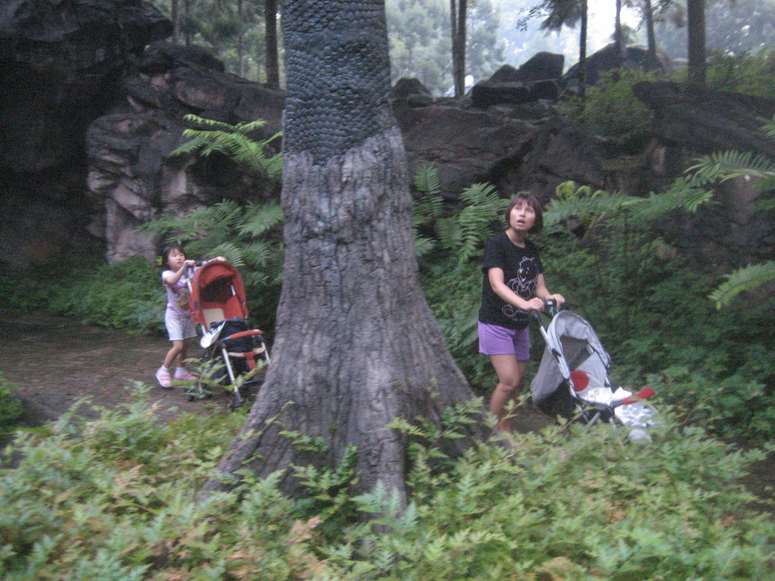
Singapore Evolution Garden
Notes:
358 to 298 million years ago. Lepidodendron, an extinct genus of vascular, tree plants related to the clubmosses. The towering models of Lepidodendron with their scale-like trunks that you see here represent the Carboniferous era. (Evolution gardens brochure)

Slide 37
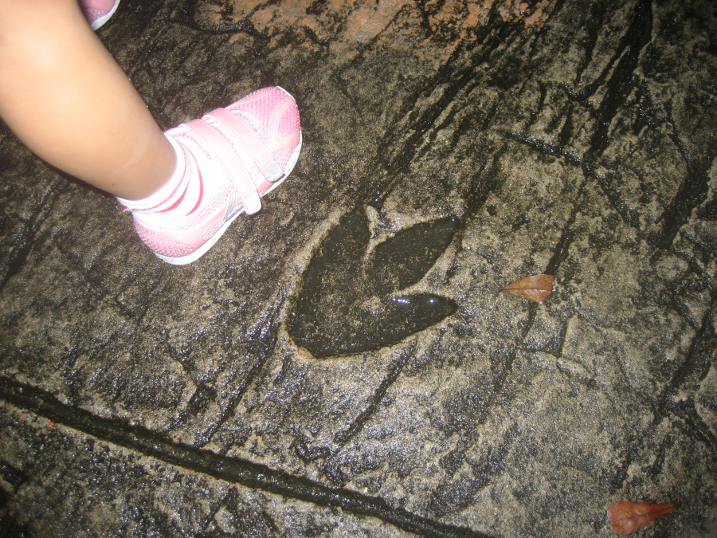
Singapore Evolution Garden

Slide 38

Creation 35(1),
January 2013

Slide 39

Richard Dawkins on Young-Earth Creationists
Anyone who thinks the world is less than 10,000 years old … you have to be staggeringly ignorant, which most of them are, or if you are not ignorant, you have got to be insane.
Notes:
http://www.youtube.com/watch?v=YqYASxal-PI
Richard Dawkins on Young Earth Creationists
Anyone who thinks the world is less than 10000 years old … the best excuse for them is lamentable ignorance. Ignorance is no crime but it is something to be remedied by education. Anybody who is not ignorant, anybody who has been shown the facts and still believes the world is less than 10000 years old, there’s got to be something wrong with them. To give an idea of the magnitude of the error, to believe that the world is less than 10,000 years old given that we know the world is actually 4.6 billion years old is equivalent to believing that the width of North America, right across from New York to San Francisco, is less than 10 yards. And that is the scale of the error we are talking about. So you have to be staggeringly ignorant, which most of them are, or if you are not ignorant you have got to be insane. …
[These people have been told:] Don’t believe when people bring something they call evidence. Faith is more important than evidence.
We have a history of 4 billion years of gradual evolution. Just think about it. 4 billion years

Slide 40
Time:
All radioactive ‘dates’ are based on assumptions.
They are not scientific facts.

Slide 41
Rate = 30 ml/hour

Slide 42
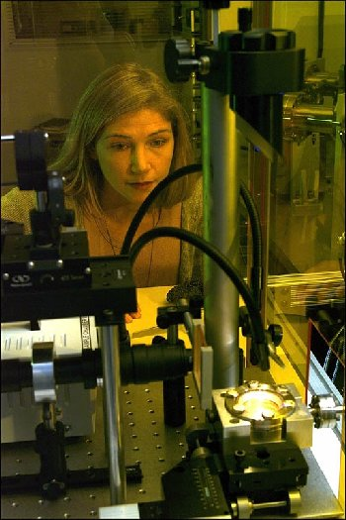
Mass spectrometer Ar/Ar
High Precision Ar–Ar Mass Spectrometer
It does not measure age
It measures Ar in the PRESENT

Slide 43

Any gained?
Potassium
Starting amount?
Any lost?
Rate?
Any gained?
Starting amount?
Argon
Any lost?

Slide 44

Scientific Dating Methods
No Instrument can measure age
Every age calculation is based on assumptions
Scientists change their assumptions to make sense of the measurements

Slide 45
Time:
Scientists change their assumptions to make sense of the measurements

Slide 46
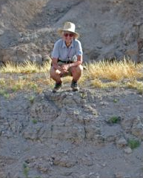
KBS Tuff
Notes:
Kay Behrensmeyer on the KBS tuff she discovered in 1969.
http://www.mnh.si.edu/ete/ETE_People_Behrensmeyer_ResearchThemes_Turkana.html

Slide 47

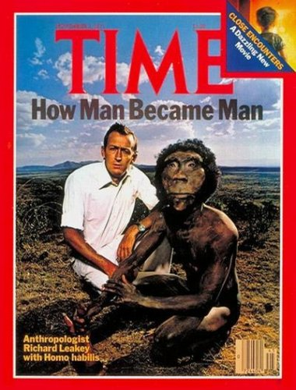

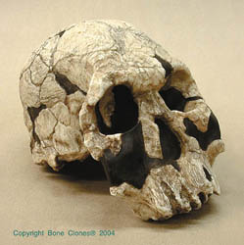
Fossils: elephant, pig, ape, tools
KBS tuff
(Kay Behrensmeyer Site)
K-Ar tuff: 212–230 Ma
K-Ar feldspar, pumice: 2.61 Ma
Confirmed: paleomagnetism, fission tracks
Skull KNM-ER 1470
K-Ar feldspar, pumice: 1.82 Ma
Confirmed: paleomagnetism, fission tracks
Notes:
Eastern shore of Lake Turkana, East Africa. Fitch & Miller did the first two K-Ar datings 1970. Curtis et al. did the last 1.82 Ma date 1975. Skull KNM-ER 1470 found 1972 & named by Richard Leakey. See The Pigs Took It All, and summary Creation 30(3):29, 2008. Kay Behrensmeyer Site (First found stone tools at the site).

Slide 48

Volcanic Lava
Along border
Rubidium-Strontium Isochron
= 773 million years
Relatively young
Possibly historic times
Interpreted as a mixing line.
Faure, G., Principles of Isotope Geology, 2nd ed., John Wiley & Sons, New York, pp. 145–147, 1986.
Notes:
Faure gives an example of volcanic lava along the border of Uganda, Zaire (now Democratic Republic of Congo) and Rwanda, East Africa. That lava is known to be relatively young, possibly erupted within historical times,⁴ yet a rubidium-strontium straight-line isochron gave an age of 773 million years. Does this worry these scientists? No. They have total faith in the method. In their minds, the key is the way the results are interpreted. Faure says that in this case we should interpret the line, not as an isochron, but a “mixing line”. So how can we tell the difference? We can’t. The only way we can know it is a mixing line is if the calculated age is wrong—and the only way one can ‘know’ if an age is right or wrong is to have a pre-existing belief about what the age should be.
Radioactive dating methods: Ways they make conflicting results tell the same story, Creation 32 (4):30–31, 2010.

Slide 49

Amphibolite
South-east India
Nellore-Khammam schist belt
Rubidium-Strontium Isochron = 481 million years
Samarium-neodymium isochron = 824 million years
Okudaira, T., Hamamoto, T., Prasad, B.H. and Kumar, R., Sm-Nd and Rb-Sr dating of amphibolite from the Nellore-Khammam schist belt, S.E. India: constraints on the collision of the Eastern Ghats terrane and Dharwar-Bastarcraton, Geological Magazine 138(4):495–498, 2001
Notes:
In another example, Okudaira et al. measured isochron ages of a rock called amphibolite sampled from south-east India. With the rubidium-strontium method they obtained an age of 481 million years but with samarium-neodymium the age was almost double at 824 million years.⁵ Did the disagreement cause the researchers to doubt the dating methods? Not at all. They removed the disagreement by the way they ‘interpreted’ the results. They said the older age was the age the rocks underwent metamorphism, while the younger age was when the rocks were later heated. How did they know? No matter what the numbers are, a plausible story can always be invented after the results are obtained.
Radioactive dating methods: Ways they make conflicting results tell the same story, Creation 32 (4):30–31, 2010.

Slide 50
Granitic pluton
Southern India
Lead-lead method
= 508 million years
Potassium-argon method
= 450 million years
Uranium-lead on zircons
= 572 million years
Miyazaki, T. and Santosh, M., Cooling history of the Puttetti alkali syenite pluton, Southern India, Gondwana Research 8(4):576–574, 2005.
Notes:
Another example involves a volcanic region in Southern India, a pluton.⁶ Using the lead-lead method, a whole-rock sample gave an age of 508 million years. With the potassium-argon method, samples of mica gave an age of 450 million years. Zircons using the uranium-lead method gave an age of 572 million years. Three different samples; three different methods; three different results. Did this cause the researchers to doubt the radioactive dating methods? No. They just applied some creative interpretation. They said the different ages are because the huge pluton cooled slowly over millions of years and the different minerals were affected in different ways. Instead of a problem, the conflict became a new discovery.
Radioactive dating methods: Ways they make conflicting results tell the same story, Creation 32 (4):30–31, 2010.

Slide 51
Time
Noah’s Flood washes away the millions of years

Slide 52
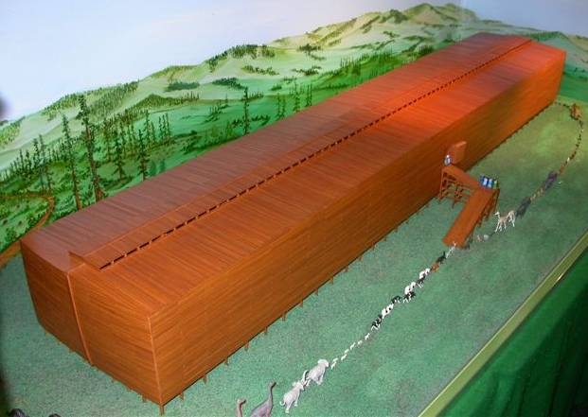
140 m
Carrying capacity: 15,000 tons!
Korean naval architects showed that the shape would have been very stable in huge seas.
Notes:
300 cubits long

Slide 53
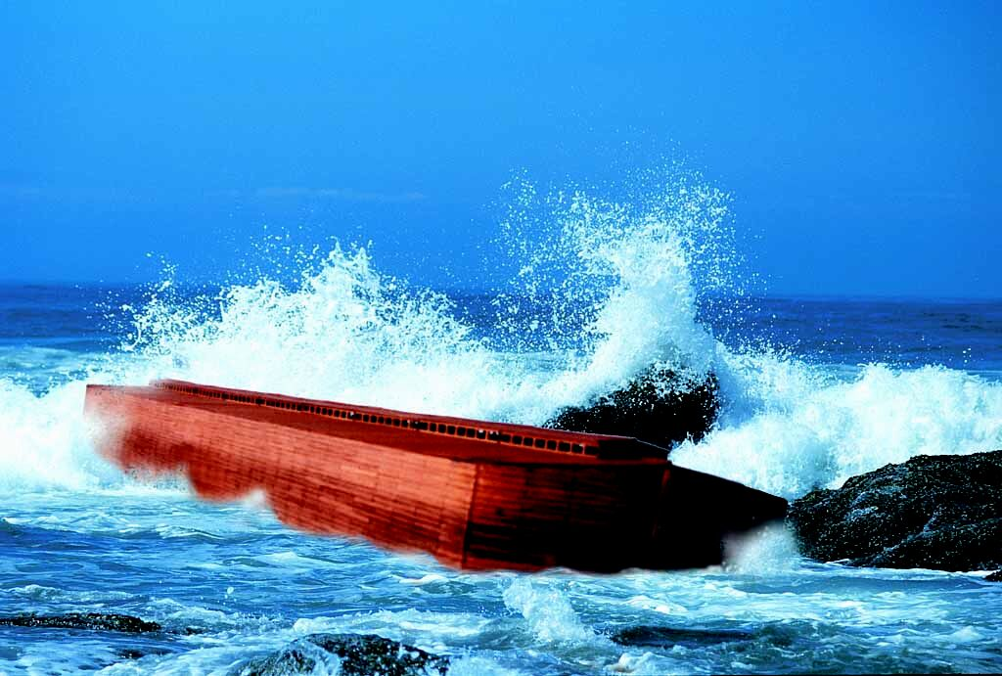
Ark at sea

Slide 54
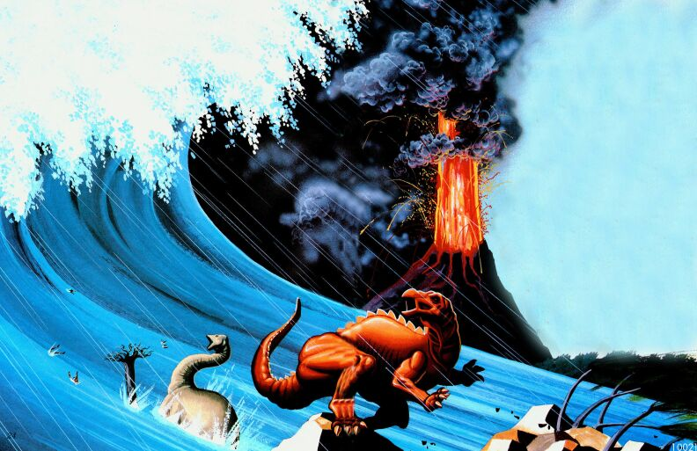
Dinos fleeing wave

Slide 55
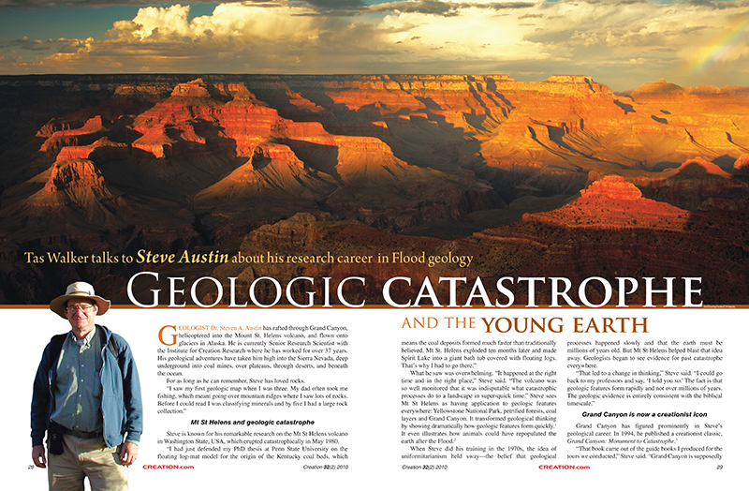
A LOT OF WATER AND A SHORT TIME
A LITTLE WATER AND A LONG, LONG TIME

Slide 56
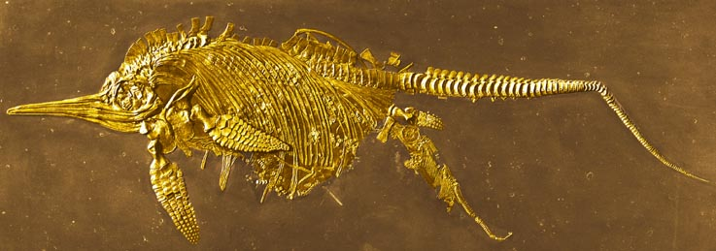
Ichthyosaur giving birth
2 metres
Ichthyosaur giving birth!
—‘snap frozen in time’

Slide 57
Time
There are many evidences that rocks can form rapidly

Slide 58

Notes:
A framed blank background such as this, may be used for tables/graphs etc, that need an uninterrupted background.

Slide 59
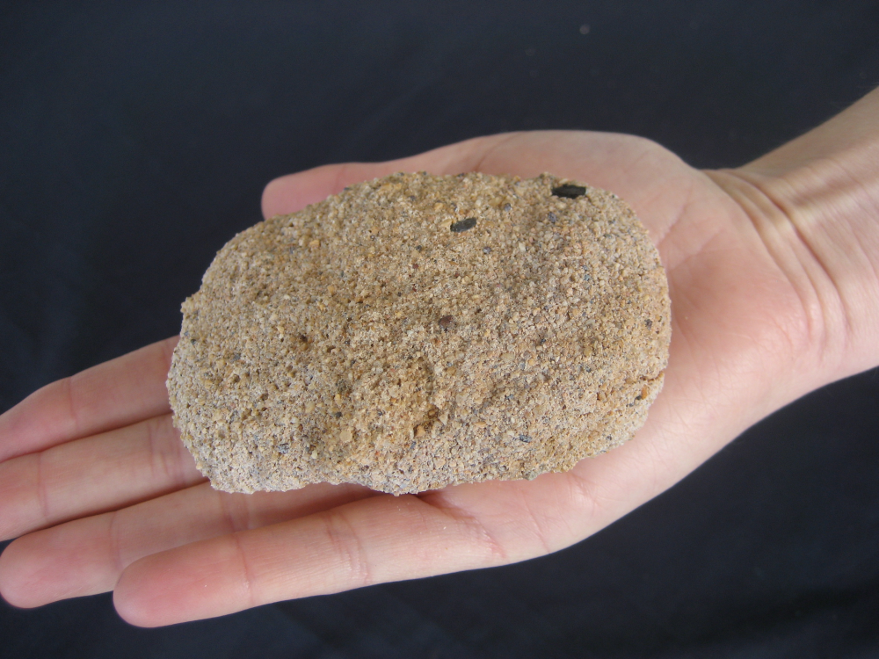
Notes:
A framed blank background such as this, may be used for tables/graphs etc, that need an uninterrupted background.

Slide 60
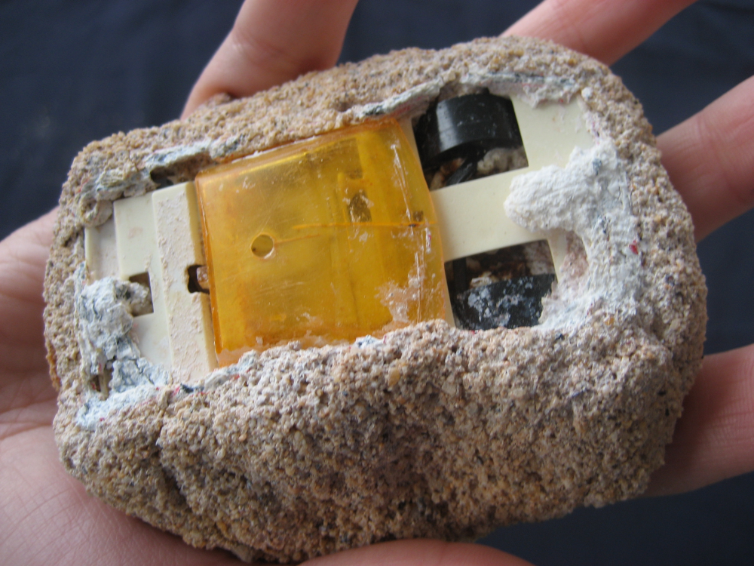
Notes:
A framed blank background such as this, may be used for tables/graphs etc, that need an uninterrupted background.

Slide 61
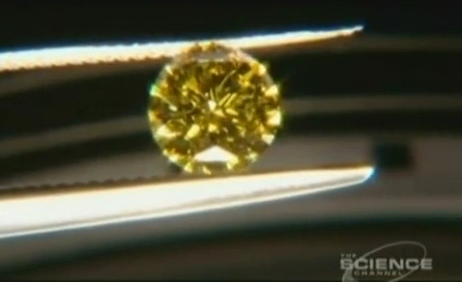
Notes:
http://www.youtube.com/watch?v=PILlP_yDZ2o
How do they do artificial diamonds?
Gemesis
Chris Owens oversees the seeding, growing and harvesting of up to 40 diamonds every day.
Diamonds made in 4 days

Slide 62
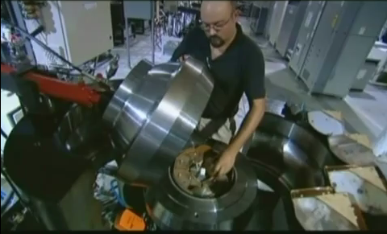
Diamonds
Notes:
High temperature/ High pressure/ steel vessel.
Gemesis
Chris Owens oversees the seeding, growing and harvesting of up to 40 diamonds every day.
Diamonds made in 4 days
http://www.youtube.com/watch?v=PILlP_yDZ2o How do they do artificial diamonds?

Slide 63
Notes:
http://www.youtube.com/watch?v=PILlP_yDZ2o
How do they do artificial diamonds?
Gemesis
Chris Owens oversees the seeding, growing and harvesting of up to 40 diamonds every day.
Diamonds made in 4 days

Slide 64
Time:
There are many evidences that give a young age

Slide 65
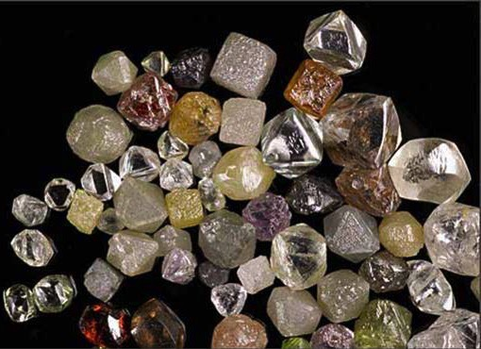

Uniformitarian age
~1 billion years
Diamonds
Carbon-14 ‘age’
Thousands of years

Slide 66
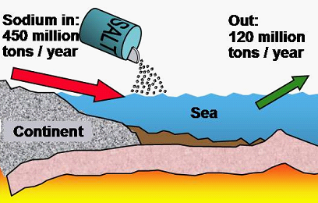
Maximum age 62 million years

Slide 67
Different Interpretations of Results
EVOLUTIONIST: ‘Age’ is too YOUNG! New Discovery!! Salt must recycle or accumulate somewhere that we don’t know about yet.
CREATIONIST: ‘Age’ is too OLD! Salt would have accumulated much faster during the Flood. Once we take the Flood into account we get the right age of 4,300 years.

Slide 68
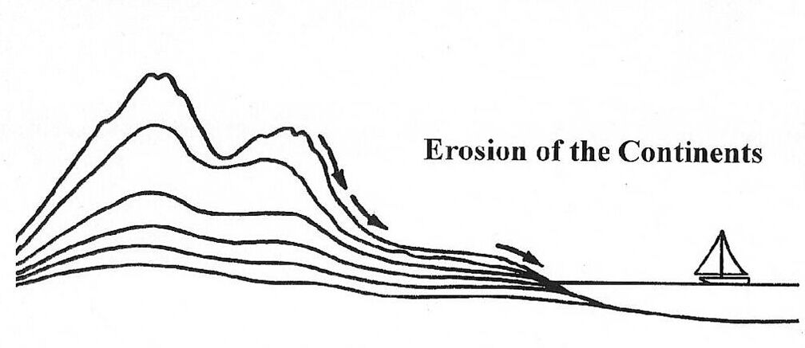
At present rates the continents would all be eroded in no more than 14 million years

Slide 69

Different interpretations of the results.
EVOLUTIONIST: ‘Age’ is too YOUNG! New discovery! Erosion must have been less in the past or mountains are lifting up.
CREATIONIST: This evidence supports the continents being young, as we expected. There was a great amount of erosion during the Flood but very little since..

Slide 70
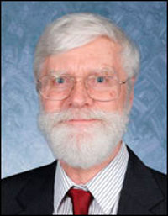
Evidence Suppressed
When at that time I began to
encounter scientific evidence
for a young world, it was a
huge shock. … When I submitted my first articles pointing to some young-world evidence to secular science journals, … the editors and reviewers of those journals absolutely refuse to publish such articles.
D. Russell Humphreys, Physicist, 2012.
Notes:
Russell H., United States, 4 August 2012
Well, Don, people like Dr. O. are examples of the value of CMI's hard work. I hope he will read this comment, because he is exactly at the point I was as a one-year-old Christian in 1970. I was a grad student in physics then, two years before I received my Ph.D. I, too, had Dr. O's naive attitude toward the uniformitarian science establishment. I believed in the billions of years, and I still had vestiges of theistic evolutionism. Most importantly, I believed that if there was evidence for a young world, I would be reading about it in the science journals and textbooks. As it turned out, that was a misplaced faith.
When at that time I began to encounter scientific evidence for a young world, it was a huge shock. I became angry because my teachers and the journals had not pointed out that evidence. When I submitted my first articles pointing to some young-world evidence to secular science journals, I found out why. The editors and reviewers of those journals absolutely refuse to publish such articles. They would publish other articles of mine, but none with young-world evidence. Every creationist scientist has found this out for himself.
In my physics career at a National Laboratory, I found out that most scientists have never encountered such evidence. It turns out that most scientists believe the earth is old because they believe that most other scientists believe the earth is old!
So I exhort Dr. O. to abandon his faith in the science establishment and dig into the evidence for himself. The good news is that he will then find he can take the Scriptural declarations of a young world at face value. That will open up the Bible to him, and enable him to know the God of the Bible much more closely.
http://creation.com/biblical-earth-age-objection

Slide 71
Time:
There is only one way of reliably knowing the age of something

Slide 72
ONLY SURE WAY
Birth Certificate
Bill Jones
Doctor Who Saw
Nurse Was There
EYEWITNESSES
WRITTEN
RECORD

Slide 73

Fall of Singapore
15 February 1942
Notes:
St Andrews Cathedral, Singapore. After falling to the Japanese on 15 February 1942. Used as a hospital.

Slide 74
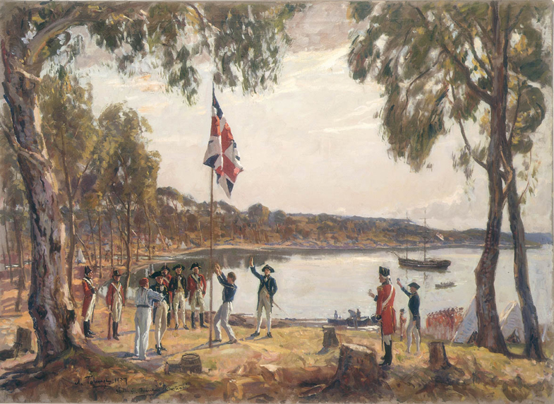
Founding of Australia
26 January 1788
Notes:
The Founding of Australia. By Capt. Arthur Phillip R.N. Sydney Cove (Port Jackson), Jan. 26th 1788, Algernon Talmadge R.A, 1937, Courtesy State Library of New South Wales
The First Fleet of 11 ships, each one no larger than a Manly ferry, left Portsmouth in 1787 with more than 1480 men, women and children onboard. Although most were British, there were also African, American and French convicts. After a voyage of three months the First Fleet arrived at Botany Bay on 24 January 1788.
http://www.migrationheritage.nsw.gov.au/exhibition/objectsthroughtime-history/ott1788/

Slide 75

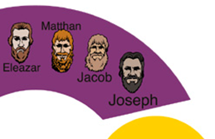
Adam to Christ

Slide 76
Time:
All radioactive ‘dates’ are based on assumptions.
They are not scientific facts.

Slide 77
Time:
Evidence and logic support the biblical age of the earth

Slide 78
The earth is young:
Naturalism is dead
Biblical history is confirmed
God is good
People are special
Sin is serious
Jesus Christ can be trusted
We have been created for a purpose

Slide 79


Creation.com

Slide 80

Notes:
Creation magazine promo

Slide 81


Slide 82

Notes:
Big Argument – Does God exist?
By Michael J. Westcott & Dr. John F. Ashton

Slide 83


Slide 84

Notes:
Age Of the Earth
84

Slide 85

Notes:
The Young Earth

Slide 86


Slide 88

Singapore

Slide 89
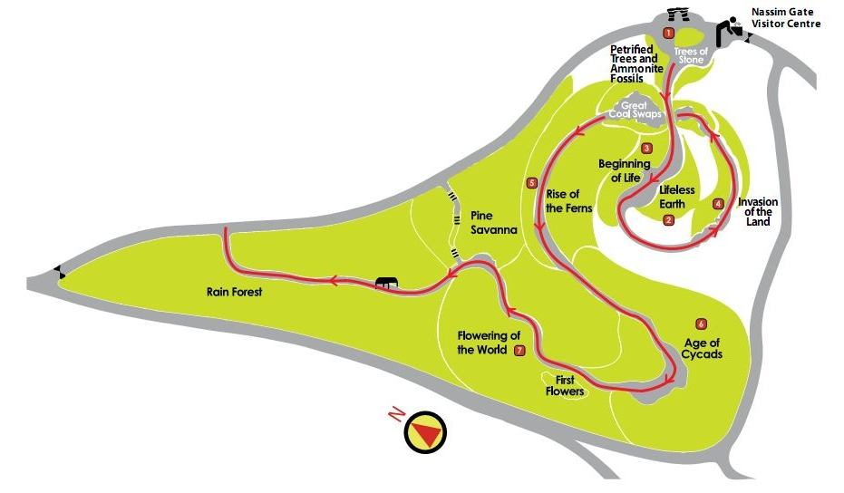
Singapore Evolution Garden

Slide 90

Singapore Evolution Garden

Slide 91
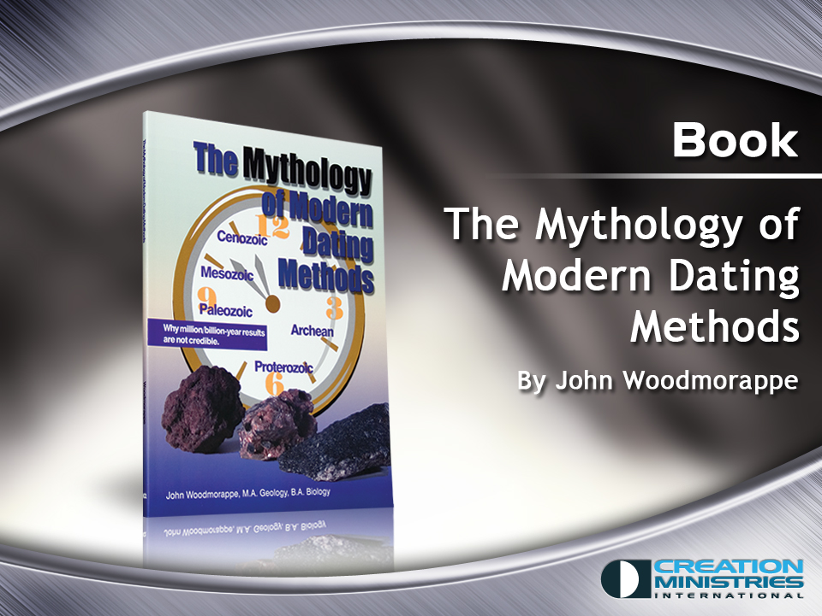
Notes:
Mythology of Modern Dating Methods
By John Woodmorappe

Slide 92

2 pet 3:8. One day is as 1000 years
2 Peter 3:8
But do not forget this one thing, dear friends: With the Lord a day is like a thousand years,

Slide 93

2 pet 3:8. One day is as 1000 years
2 Peter 3:8
But do not forget this one thing, dear friends: With the Lord a day is like a thousand years,
and a thousand
years are like
a day.

Slide 94
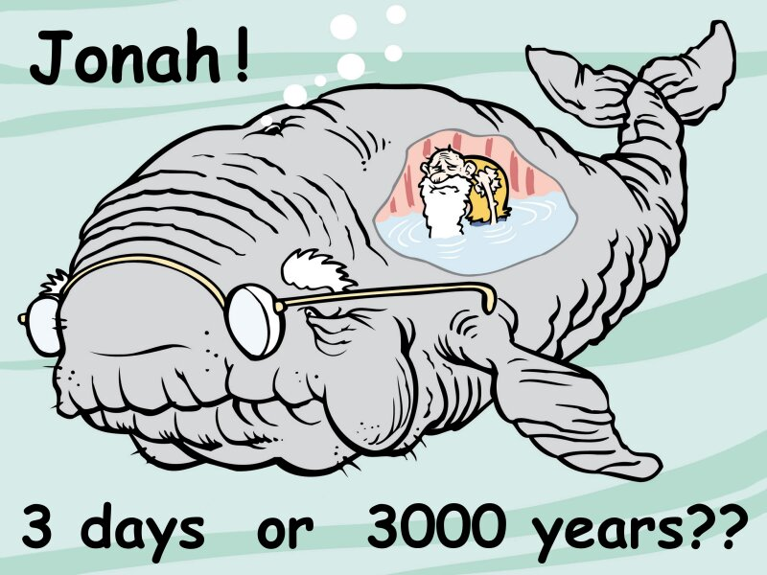
Jonah, 3 days or 3000 years

Slide 95

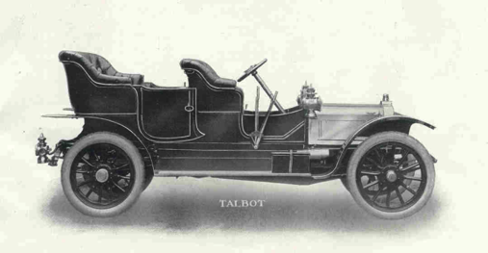
Meanings of “day” in English
In my father’s day, it took six days to drive across Australia, driving during the day.

Slide 96






Genesis 1
V. 5 God called the light "day," and the darkness he called "night." And there was evening, and there was morning—the first day.
V.8 God called the expanse "sky." And there was evening, and there was morning—the second day.
V.13 And there was evening, and there was morning—the third day.
V.19 And there was evening, and there was morning—the fourth day.
V.23 And there was evening, and there was morning—the fifth day.
V.31 God saw all that he had made, and it was very good. And there was evening, and there was morning—the sixth day.

Slide 97
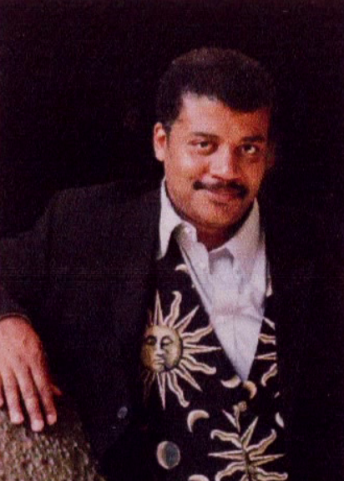
Neil deGrasse Tyson
Does the universe have a purpose?
Notes:
Neil deGrasse Tyson was asked by the Templeton Foundation to respond to the question, “Does the Universe Have a Purpose?”
https://www.youtube.com/watch?v=7pL5vzIMAhs&feature=youtu.be

Slide 98

Notes:
What would the purpose be? That carbon based life was inevitable? That sentient life, would be primates’ neurological pinnacle?
https://www.youtube.com/watch?v=7pL5vzIMAhs&feature=youtu.be

Slide 99
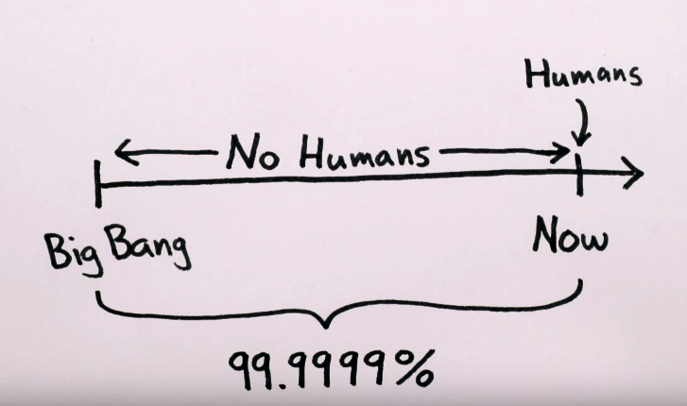
Notes:
Was the purpose of the universe to create humans? But of course humans were not around to ask these questions for 99.9999% of its history.
https://www.youtube.com/watch?v=7pL5vzIMAhs&feature=youtu.be

Slide 100
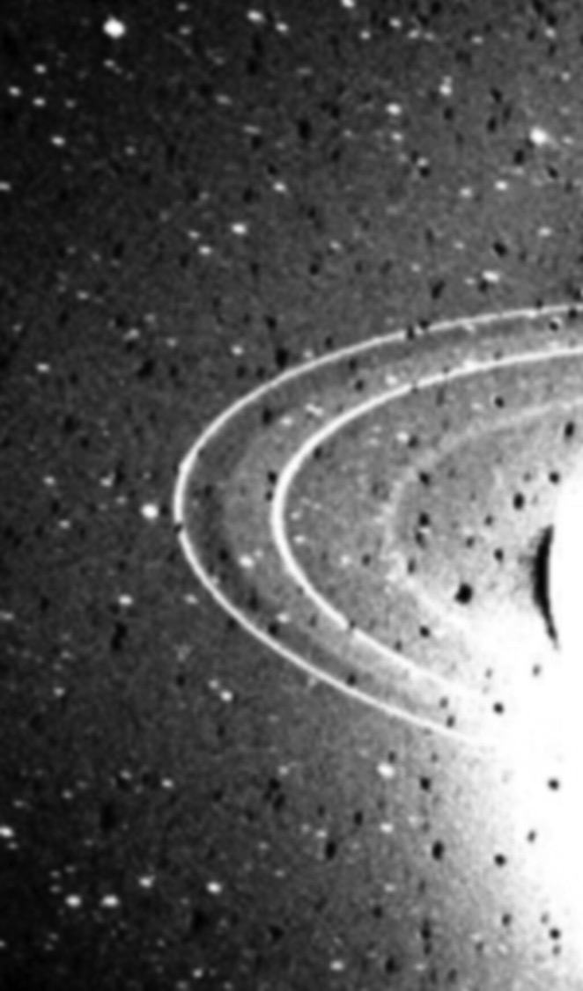
Neptune’s rings are disappearing

Slide 101
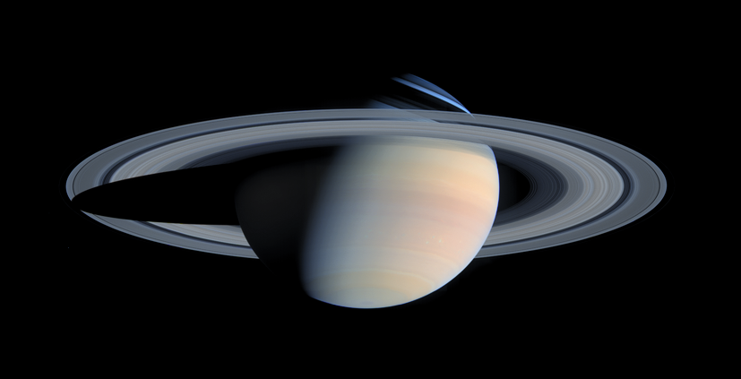
Saturn’s rings are growing dimmer

Slide 102
Noah’s Flood washes away the millions of years

Slide 103
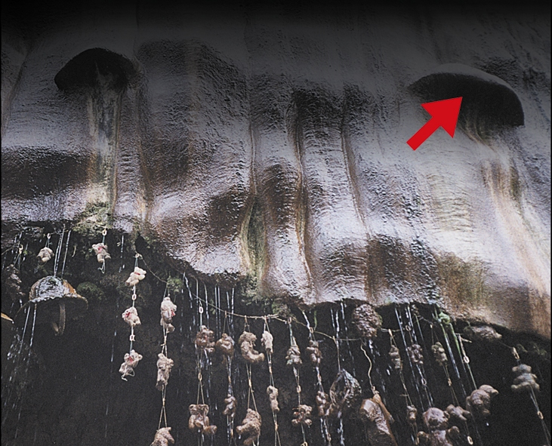
Hat entombed in limestone
An 1853 hat largely entombed in flowstone.
An 1853 hat largely entombed in flowstone.
Notes:
Creation magazine, June 2002, pp. 48-49.

Slide 104

The Amazing Stone bears
The Amazing Stone Bears of Yorkshire
Creation magazine, June 2002, pp. 48–49.

Slide 105
‘Dating’ the Earth

Slide 106
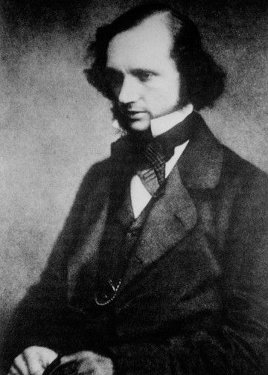
William Thompson
(Lord Kelvin)
Physicist, Glasgow.
1862 published calculations of age of the earth:
20 to 400 million years
Notes:
In 1862, the physicist William Thomson (who later became Lord Kelvin) of Glasgow published calculations that fixed the age of Earth at between 20 million and 400 million years
Geologists had trouble accepting such a short age for Earth. Biologists could accept that Earth might have a finite age, but even 100 million years seemed much too short to be plausible. Charles Darwin, who had studied Lyell's work, had proposed his theory of the evolution of organisms by natural selection, a process whose combination of random heritable variation and cumulative selection implies great expanses of time. (Geneticists have subsequently measured the rate of genetic divergence of species, using the molecular clock, to date the last universal ancestor of all living organisms no later than 3.5 to 3.8 billion years ago).
In a lecture in 1869, Darwin's great advocate, Thomas H. Huxley, attacked Thomson's calculations, suggesting they appeared precise in themselves but were based on faulty assumptions.
The last estimate Thomson gave, in 1897, was: "that it was more than 20 and less than 40 million year old, and probably much nearer 20 than 40"

Slide 107
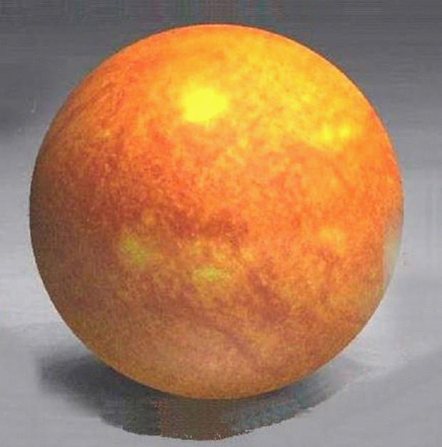
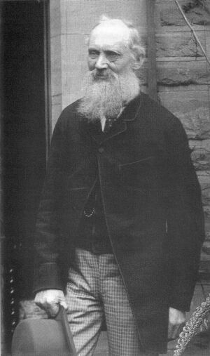
Lord Kelvin
TEMPERATURE
Assumed
Earth
cooled
from
a molten
ball
TIME
Calculated age ~ 40 million years

Slide 108

Earth from space
… and the Spirit of God was hovering
over the waters.
Genesis 1:2

Slide 109

Helmholtz: Assumed gravitational collapse
Calculated age ~ 40 million years

Slide 110
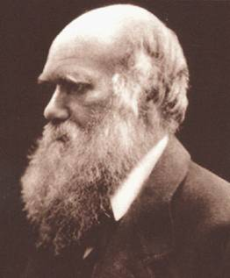
Lord Kelvin
My ‘sorest trouble’ An ‘odious spectre’
“I am greatly troubled at
the short duration of the world according to Sir W. Thomson for I require for my theoretical views a very long period before the Cambrian formation.”
Notes:
The correspondence of Charles Darwin, volume 17: 1869
Edited by Frederick Burkhardt, James A. Secord, Sheila Ann Dean, Samantha Evans, Shelley Innes, Alison M. Pearn, Paul White. (Cambridge University Press 2009)
letter to James Croll, 31 January [1869]
http://www.darwinproject.ac.uk/correspondence-volume-17

Slide 111
40 million years was too young
For uniformitarian geology
For evolutionary biology

Slide 112

The dynamics of the debate changed dramatically when (Antoine-) Henri Becquerel
(1852–1908) discovered radioactivity in 1896.
Heat generated by the radioactive decay of elements within the earth was quickly invoked to explain cooling of the earth over long ages.

Slide 113
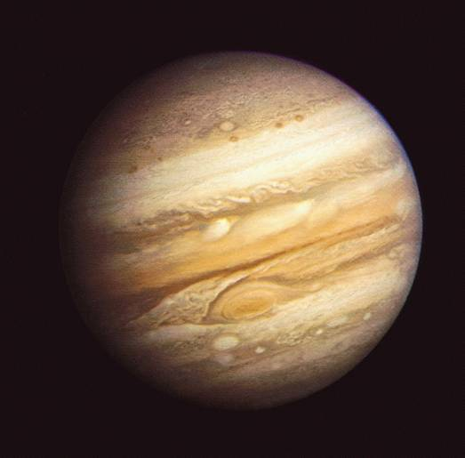
Jupiter
Jupiter is not in thermal heat balance
Radiates significantly more heat than it receives

Slide 114

Arthur Holmes (1890–1965 )
Pioneer of geochronology.
First radioisotope ‘date’ 1911.
Earth's age 1,600 Ma (1912)
A curious complication emerged in the late 1940s. As the age of the earth gradually crept up towards 3000 million years, and beyond,
the earth eventually became twice as old as the universe.
Lewis, C., The Dating Game, Cambridge University Press, p. 191, 2000.
Notes:
Holmes performed the first uranium-lead radiometric dating (specifically designed to measure the age of a rock) while an undergraduate at the Royal College of Science (now Imperial College) in London, assigning an age of 370 Ma to a Devonian rock from Norway. This result was published in 1911, after his graduation in 1910.
1912 saw Holmes on the staff of Imperial College, publishing his famous booklet The Age of the Earth in 1913 (he estimated the Earth's age to be 1,600 Ma).

Slide 115
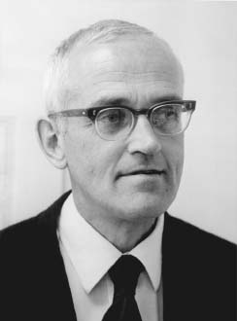
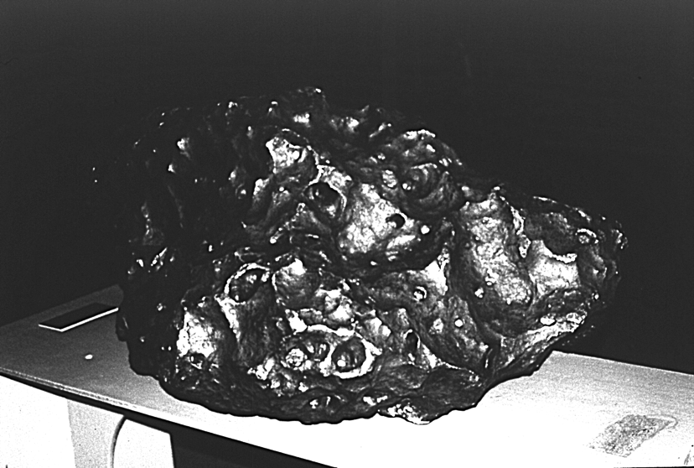
Calculated Age
4.55 Billion years
Clair Patterson

Slide 116

Nebula
Hypothesis

Slide 117
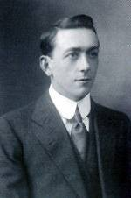
A.A. Holmes
Pioneer in radioisotopic dating
“… to use the isotopic composition of lead from iron meteorites as part of the basic data for calculating the age of the earth or its crust, is unsound in principle … the correct procedure is to use terrestrial materials.”

Slide 118
Patterson was lucky!!
‘Patterson’s results were more fortuitous than was realised fifty years ago.’
Lewis, C., The Dating Game, Cambridge University Press, p. 228, 2000.

Slide 119
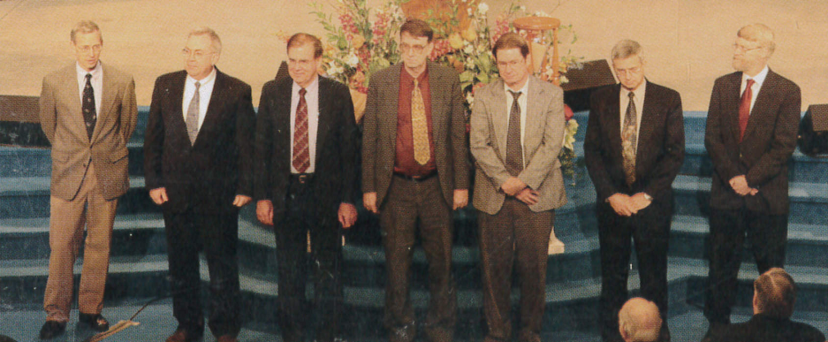
RATE Group
Notes:
RATE Group
Don De Young, Larry Vardiman?, John Baumgardner, Eugene Chaffin?, Steve Austin, Andrew Snelling, Russ Humphreys.

Slide 120

Notes:
Radioisotopes & the Age of the Earth 2
By Drs Larry Vardiman, Andrew A. Snelling and Eugine F. Chaffin

Slide 121
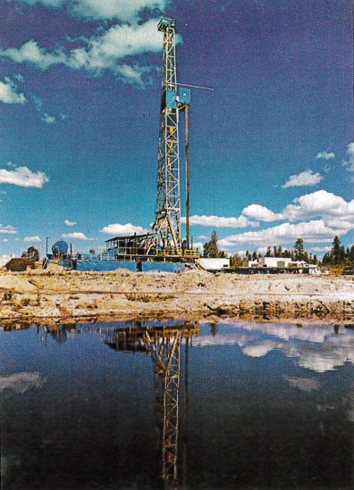
Drilling Rig,
Fenton Hill,
New Mexico
Notes:
Drilling Rig at Fenton Hill, New Mexico. Los Alamos National Laboratory.
Just west of the volcanic Valles Caldera, in the Jemez Mountains, near Los Alamos. In borehole GT-2 they sampled granitic Precambrian rock called Jemez granodiorite. Assigned radioisotope ‘age’ 1.5 billion years. Depth of samples varied from near surface to 4.3 km.

Slide 122
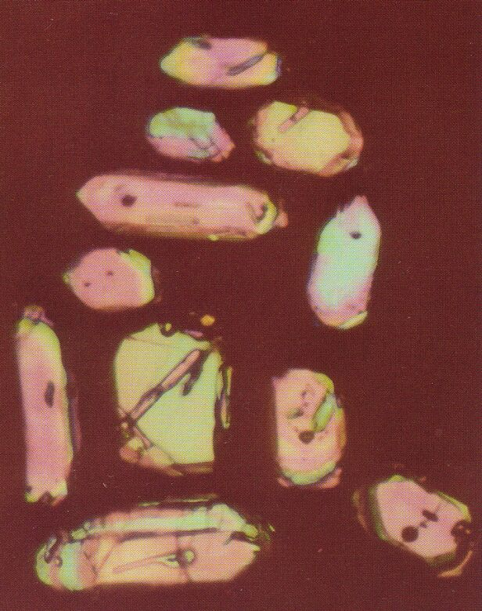
ZIRCON
CRYSTALS

Slide 123
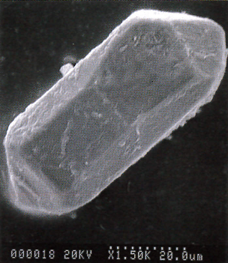
Zircon Crystal
Under
Electron
Microscope
Notes:
Scanning electron microscope image of zircon. Note 20 micron scale at bottom right.
Drilling Rig at Fenton Hill, New Mexico. Los Alamos National Laboratory.
Just west of the volcanic Valles Caldera, in the Jemez Mountains, near Los Alamos. In borehole GT-2 they sampled granitic Precambrian rock called Jemez granodiorite. Assigned radioisotope ‘age’ 1.5 billion years. Depth of samples varied from near surface to 4.3 km.

Slide 124
RATE Group, Zircons from granite
Humphreys and Baumgardner, ICC, 2003
Age 5,680 ± 2,000 years
He
He
He
He
He
He
U
He
He
Pb
Calculated age = 1.5 billion years

Slide 125
Time:
Isochron method: Claims they do not assume the inititial concentration, but they actually do

Slide 126
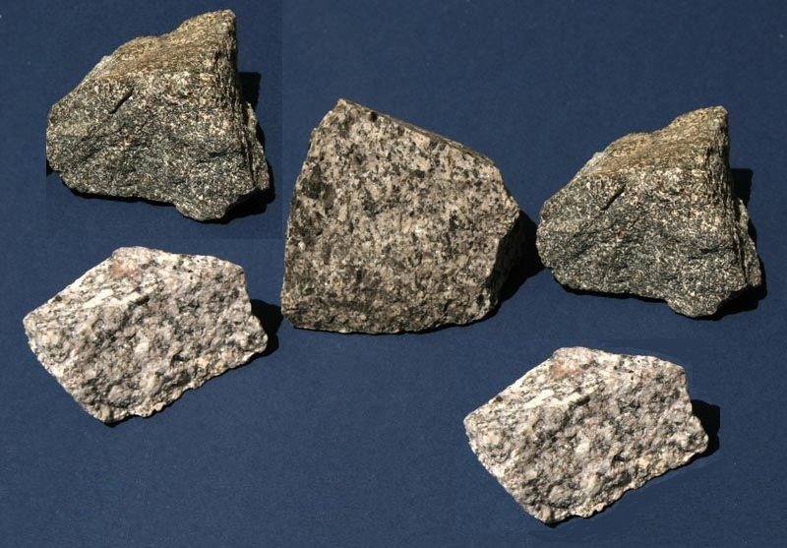

Slide 127
Rubidium→Strontium
⁸⁷Sr
⁸⁶Sr
Assumed initial concentration ALL samples
⁸⁷Rb
⁸⁶Sr

Slide 128
Rubidium→Strontium
⁸⁷Sr
⁸⁶Sr
⁸⁷Rb
⁸⁶Sr

Slide 129
Rubidium→Strontium
⁸⁷Sr
⁸⁶Sr
⁸⁷Rb
⁸⁶Sr

Slide 130
Time:
Scientists change their assumptions to make sense of the measurements

Slide 131

Uses of Day outside Genesis - 2

Slide 132

Uses of Day outside Genesis - 3

Slide 133

Uses of Day outside Genesis - 4

Slide 134

Uses of Day outside Genesis - 5

Slide 135

US Declaration of Independence
4 July 1776
Notes:
http://www.neptunepictures.com/trafalgar.htm

Slide 136
Dating of Rocks

Slide 137
Potassium→Argon
Uranium→Lead
Thorium→Lead
Samarium→Neodymiun
Rubidium→Strontium

Slide 138
PARENT
EXPONENTIAL DECAY CURVE
1/2
1/4
1/8
1/16
TIME
Half-
life
Half-
life

Slide 139
Gas
Half Life = 1.26 billion years
⁴⁰Ar
⁴⁰K
⁴⁰Ca

Slide 141


Creation link at BibleStudyDownloads.org
Get this presentation for free!
Notes:
OT Survey (os)

